Slide 1
Zebra Scanner Application User Guide

Slide 2
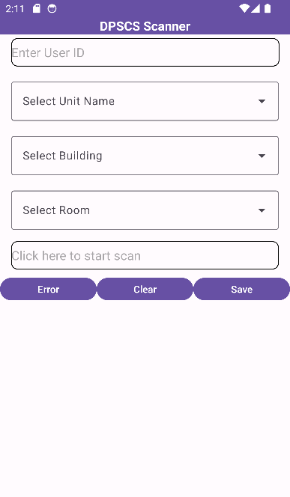
Select Fields

Slide 3
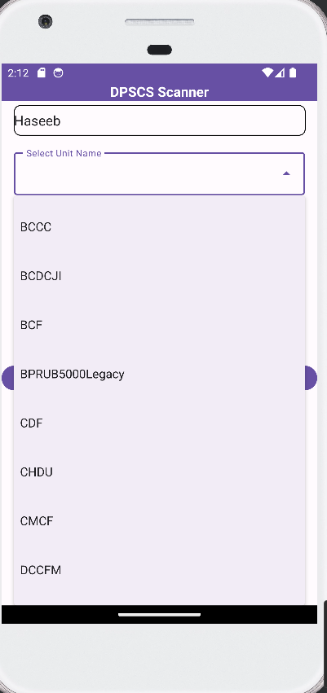
These box are searchable edit box.

Slide 4
Start Scanning

Slide 5
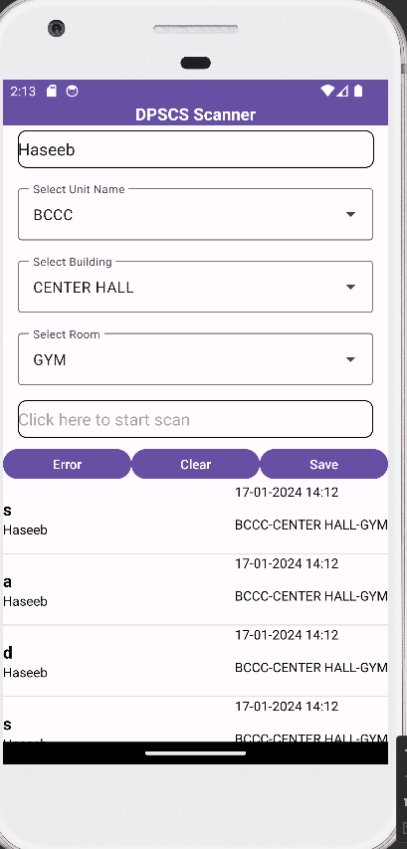
All barcode come here in drop down

Slide 6
Error= Mark Particular Record Error.

Slide 7
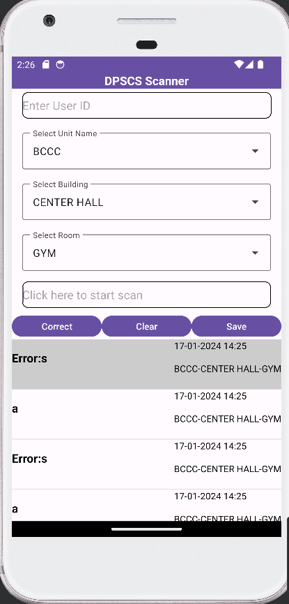
Correct Error Record.

Slide 8
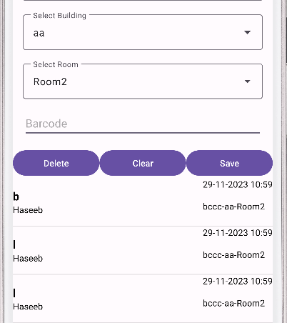
Save Barcodes.

Slide 9
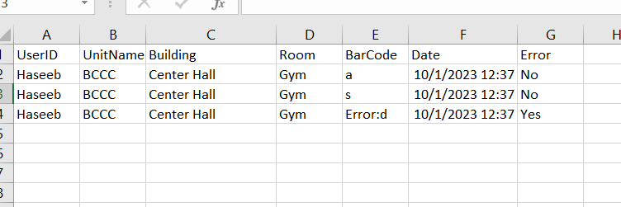
Data Save in .csv file. User will upload this file to ATS.

Slide 10
Guide to Send data from Zebra Device to ATS
Application Scan Barcodes
Send via Cable
Workstation
Upload to ATS
ATS
Export CSV File
Send via Email

Slide 11
Guide to install SDK in Zebra Devices
Email
Email on Zebra Devices
Application Scan Barcodes
SDK
USB cable at workstation
Upload SDK on portal and user need to install from there

